Slide 1
Reverse 101 : The Intro

Slide 2
Outline
Reverse Engineer?
Binary
Arsitektur Komputer
Bahasa Assembly
Disassambler
Debugger

Slide 3
Reverse Engineer
Reverse Engineering (RE): "disassemble or analyze in detail in order to discover concepts involved in manufacture." - "reverse engineer." The Merriam-Webster Dictionary, New ed. 2004.
Reverse engineering is "the process of discovering the technological principles of a mechanical application through analysis of its structure, function and operation. That involves sometimes taking something apart and analyzing its workings in detail, usually with the intention to construct a new device or program that does the same thing without actually copying anything from the original." - Wikipedia

Slide 4
Reverse Engineer
Flow
Algoritma
Malware Analisis
Crack
Keygen
For Fun

Slide 5
Binary
10(10)
1010(2)
0xA(8)

Slide 6
Bit, byte, word
bit, 0 or 1
byte = 8 bit
word = 2 byte = 16 bit
dword = 2 word = 4 byte = 32 bit
qword = 4 word = 8 byte = 64 bit

Slide 7
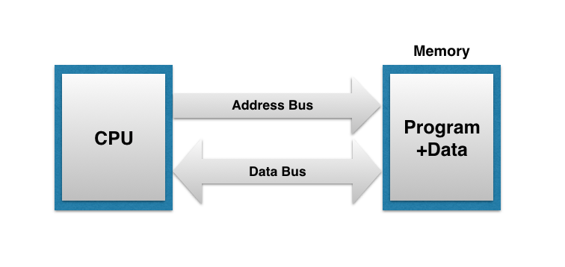
Arsitektur komputer

Slide 8
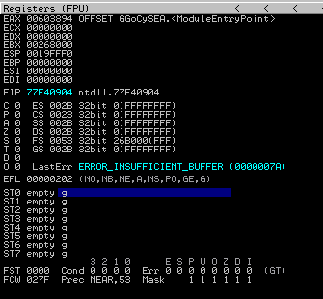

Slide 9
Register
To speed up the processor operations, the processor includes some internal memory storage locations, called registers.
The registers store data elements for processing without having to access the memory. A limited number of registers are built into the processor chip.

Slide 10
Register
General registers
Data registers
Pointer registers
Index registers
Control registers
Segment registers

Slide 11
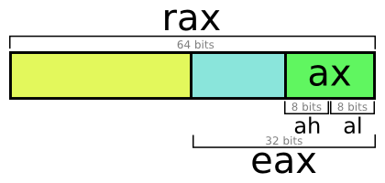
Data Register
AX,BX,CX,DX

Slide 12
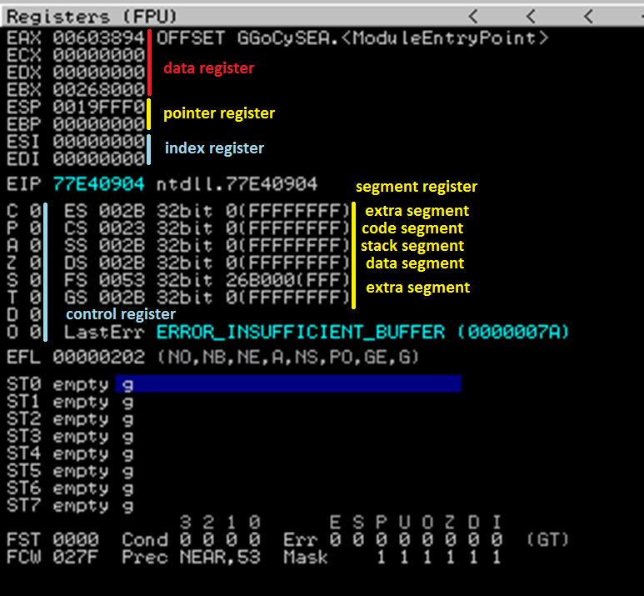

Slide 13
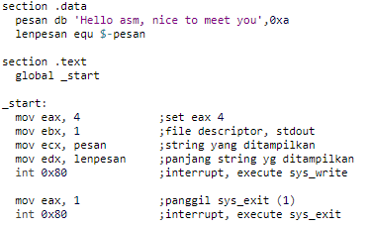
ASM

Slide 14
Disassambler
Static code analisis
IDAPro
Hopper

Slide 15
Debugger
Dynamic analisis
Ollydbg
Immunitydbg
Radare2
gdb

